Slide 1
Start Screen
Worship Together
All Fonts Calibri (check copyright)
Use zamzar.com to convert to HTML
This Week -> This Week
Favorites -> Favorites
Search -> Search Screen
Settings -> Settings
Swipe down on any screen -> Search
This Week
Favorites
Search
Settings

Slide 2
This Week
<
Lists music selections for the upcoming Sunday
Music selections chosen by music director
Touching a song -> Song Screen
Back -> Start Screen
This Week
(311)
(8)
(182)
(411)
(344)
(327)
(260)
(437)
Jesus Shall Reign
Ps 6: Chide Me, O LORD, No Longer
Ps 138: With All My Heart, My Tha…
Ps 114 (NKJV)
On Christ The Solid Rock (Fugue)
The Lord’s Prayer
Christ Is Made the Sure Foundation
The Church’s One Foundation
Jesus, Thy Blood and Righteousness
Doxology

Slide 3
Favorites
<
Lists songs which the user has selected as their favorites
Touching a song -> Song Screen
Back -> Start Screen
Favorites
(336)
(342)
(345)
(305)
(349)
(160)
A Mighty Fortress Is Our God - Sch…
Be Thou My Vision
Come, Thou Almighty King
Holy, Holy, Holy
I Bind unto Myself Today -St. Patric…
Ps 122: O, ‘Twas a Joyful Sound to …

Slide 4
Search Screen
<
Search Music
Keyboard visible
“Search Music” 40% transparent
Keystroke -> Search Results
Back -> Start Screen
|

Slide 5
Search Results
<
15|
Shows all items w/matching substring
Sort order:
Exact page match
Exact Psalm match
Partial Psalm match
Partial page match
Partial word match
Empty search box -> Search Screen
Touch song -> Song Screen
Back -> Start Screen
(15)
(17)
(196)
(150)
(151)
(152)
Ps 13: How Long, O LORD, Wilt Thou…
Ps 15 (NKJV)
Ps 15: LORD, Who Shall Dwell With…
Ps 150: Hallelujah! Praise the Lord
Ps 110: Jehovah to My Lord Has Sai…
Ps 111: Praised Be the LORD! I Shal…
Ps 116: I Love the LORD, the Fount …

Slide 6


Song Screen
<
Psalm 118: O Come with Thanks, God’s Goodness Praising (154)
Displays title, page, Psalm
Back button -> Search Results
Retains previous search criteria
Checkbox enables/disables voice
Control each voice volume separately
Single play/pause button
Slider allows movement within song
Clicking heart -> Add song to favorites
Clicking page icon -> Sheet Music
Soprano
Alto
Tenor
Bass
Piano

Slide 7
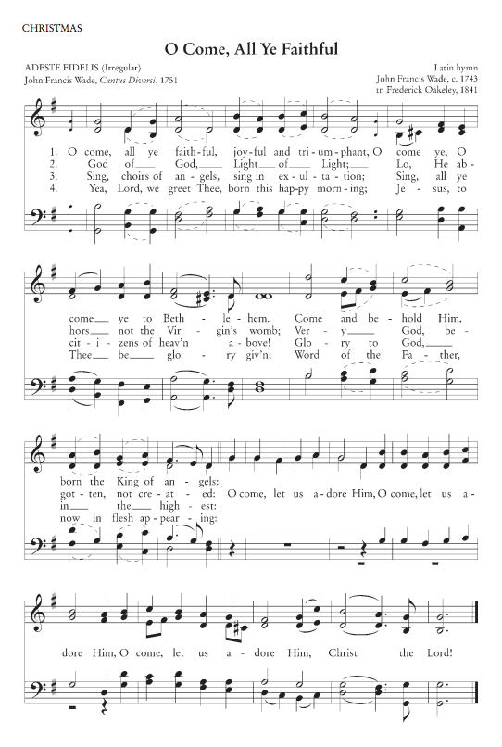
Sheet Music
<
Psalm 118: O Come with Thanks, God’s Goodness Praising (154)
Music continues to play
Can zoom & pan with fingers
Tap screen to play/pause?
Back button -> Song Screen

Slide 8
Settings
<
Select Church -> Select Church
Create Church -> Create Church
Select Weekly Songs -> Enter Password
Change Password -> Change Password
Back -> Start Screen
Select Weekly Songs only shown once a church is selected
Church creation requests submitted to app admin for approval
Settings
Select Church
Create Church
Select Weekly Songs
Change Password

Slide 9
Select Church
<
Lists all created churches
Can be scrolled up and down
Touching a church selects that church, returns to Settings
May add search capability if list becomes extremely long
Back -> Settings
This Week
Akron, PA
Moscow, ID
Oakland, ME
Ferry, MI
Carbondale, IL
Rome, GA
Nashville, TN
Baton Rouge, LA
Moscow, ID
All Saints Church
Christ Church
Christ Reformed Church
Christ the King Church
Cornerstone Reformed Ch…
Salem Reformed Church
St. Mark Reformed Church
Trinity Presbyterian Chu…
Trinity Reformed Church

Slide 10
Create Church
<
Enter church name, password and contact email
New church request submitted to administrator for approval
Back -> Settings
Return On Last Field -> Request Submitted
Create Church
Name:
Password:
Email:
|

Slide 11
Request Submitted
<
OK -> Settings
Submitted
Your request to create a new church has been submitted. You will receive an email when the request has been approved.
OK

Slide 12
Change Password
<
Enter current password
Enter new password twice
Return -> Settings
Change Password
Current:
New:
Confirm:
|

Slide 13
Enter Password
<
Enter church password -> Select Weekly Songs
Back -> Settings
Weekly Songs
Password:
|

Slide 14
Select Weekly Songs
<
Enables music selections for the upcoming Sunday
Slide song left -> Delete song
Touching a song -> Song Screen (Back returns to this screen)
Plus (+) Button -> Search Screen (Returns to this screen, adds song)
Back -> Settings
Weekly Songs
(311)
(8)
Jesus Shall Reign
Ps 6: Chide Me, O LORD, No Longer
+

